Slide 1
Academy Lab Projects – Showcase
Akshay Kumar Ghatule
Rishav Badhan
Prajwala Balachandran
Arnav Singh Bhardwaj
Cloud Web Application Builder
16th January, 2026
Notes:
For Educators: You can use this template to help your students effectively present and communicate their project to a broader audience. Your students can also use this presentation as a portfolio of their work to demonstrate their cloud skills.
The presentation structure is listed below. The total time may vary depending on the activity you want to conduct. For example, you may want your students to provide high-level walkthrough of their final solutions versus deep-dive into why or how they chose certain services and the steps of building their architectures.
Suggested timing for a 15-minute presentation:
Introduction – 30 seconds
Business scenario overview – 1 minute
Solution overview – 5 minutes
Architecture diagram of the solution – 2 minutes
Demo – 5 minutes
Lessons learned – 1.5 minutes

Slide 2
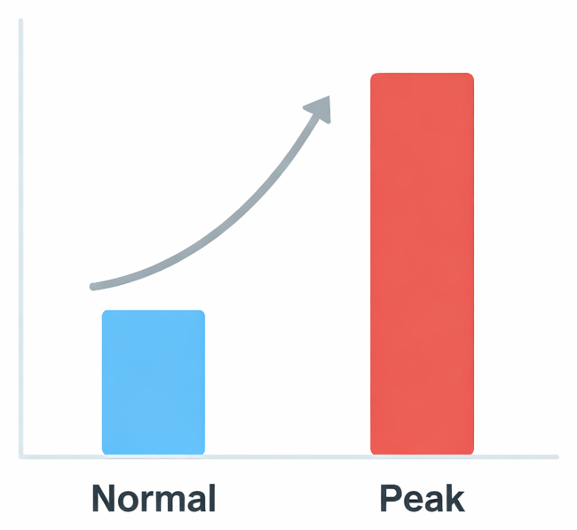
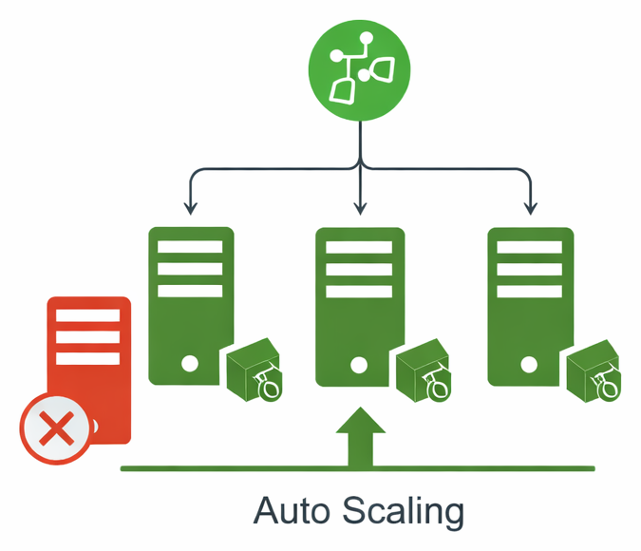
Highly Available Student Records Web App for Peak Admissions
Problem/Opportunity:
Users: applicants + admissions staff using the student records web app
Pain points: slow page loads, timeouts, intermittent downtime during peak traffic
Impact: delays in reviewing/processing applications, poor user experience, loss of trust
Opportunity: redesign to handle spikes automatically without overpaying when traffic is low
Solution requirements:
Functional: CRUD on student records with no noticeable delay
Load balanced: traffic distributed across multiple web servers
Scalable + highly available: auto scaling across 2 AZs, resilient to instance failure
Secure: DB not public, least-privilege access, secrets not hardcoded, only required ports
Cost optimized: scale out only when needed
High performing: consistent response times under normal and peak load
Notes:
Define the problem or opportunity that you are addressing. Include pictures, figures, and statistics to help the audience better conceptualize the problem or opportunity.
Specify who your users or customers are and what pain points they are experiencing.
For example: “Users complain that the student admissions department website is too slow and isn’t always available.”
Also, list any specific business requirements that you are addressing.
For example: “Improve the experience for users. The web application can be deployed to the AWS Cloud. The application must be highly available, scalable, load balanced, secure, and performant architecture that can support thousands of users.“
Note:
An above-bar overview succinctly defines the problem and opportunity statement. For example: “Customers with media files, such as retail companies, need an easy and cost-effective way to analyze photos and videos of their inventory.”
A below-bar overview is too verbose, technical, or not specific. For example: “The most common media files are .jpg and .mp4. Companies have media files of their inventory.”

Slide 3
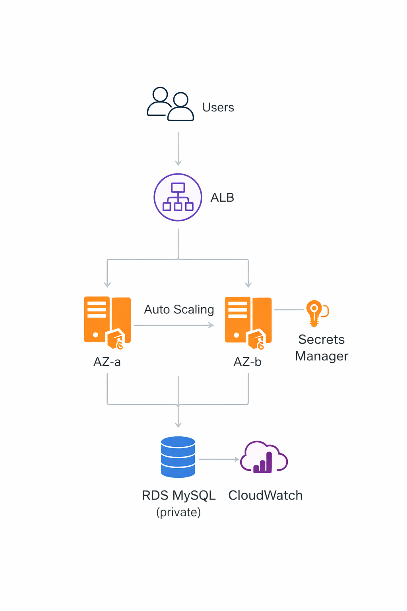
Solution overview: Fast, resilient student records app on AWS A multi-tier web app on AWS that stays responsive during traffic spikes by using load balancing, auto scaling, and a private managed database
What we have built:
Public entry point: Application Load Balancer distributes requests
Scalable web tier: EC2 Auto Scaling runs multiple app servers across 2 AZs
Secure data tier: RDS MySQL in a private subnet (single-AZ as required)
Design considerations + trade-offs:
Reliability: Multi-AZ web tier + health checks replace failed instances automatically
Security: DB is not public; least-privilege IAM; credentials stored in Secrets Manager (not in code)
Cost: Scale out only when needed (target tracking); small instances for baseline
Trade-off: RDS is Single-AZ (lab requirement) → web tier is HA, DB is the constrained component
Use cases:
Admissions staff / users can: view, add, edit, delete student records (CRUD)
System behavior under peak: application remains available and scales automatically
Admin/ops: monitor scaling and health via CloudWatch metrics
Notes:
Explain at a high level what you have built.
For example: “I built a web application for a company to host their blog.“
Talk about why you chose certain parts of the solutions and any tradeoffs that you made. Focus on how you designed the solutions and how you applied the AWS Well-Architected Framework as part of the process (AWS Well-Architected Framework: https://docs.aws.amazon.com/wellarchitected/latest/framework/welcome.html).
For example: “I configured load balancers and auto scaling to make the application highly available and reliable.”
Include the use cases that you are addressing. Think about who your users are and how they would want to interact with your solution to solve their problem.
For example: “Users can view, upload, edit, and delete blog posts. Administrators can approve blog posts.”
Talk about the use cases that you addressed as part of the minimum viable product (MVP) that you scoped and built.
Note:
An above-bar description is concise and includes the most important benefits. For example: “The solution allows customers to quickly upload, store, and search large catalogs of images and videos in Amazon S3.”
A below-bar description is too detailed or not specific. For example: “Our solution analyzes media files.”

Slide 4
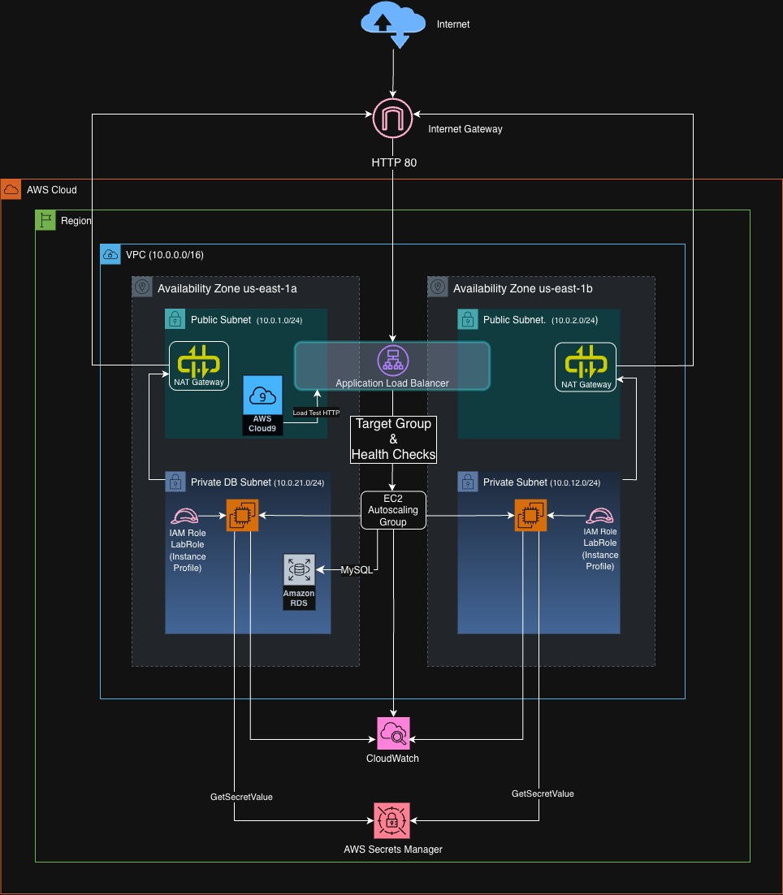
Architecture diagram of the solution
Notes:
Use the following resources to create a diagram of your application architecture:
AWS Architecture Icons at https://aws.amazon.com/architecture/icons. This page includes diagram assets as well as links to drawing and diagramming tools that you can use.
As you walk through the architecture, make sure that you relate back to the business requirements and the AWS Well-Architected Framework (https://docs.aws.amazon.com/wellarchitected/latest/framework/welcome.html).
You can also go more in depth about the design considerations and trade-offs that you made.

Slide 5
Cost Estimation (USD)
Upfront cost
Total monthly cost
Total yearly cost (12 months)
$0
$59.618
$715.416
Service cost breakdown
Monthly cost by service
Service | Monthly (USD) | First 12 Months Total (USD)
Amazon EC2 | 10.008 | 120.096
Application Load Balancer | 16.430 | 197.160
Amazon RDS for MySQL | 22.150 | 265.800
AWS Secrets Manager | 0.400 | 4.800
Amazon CloudWatch | 10.630 | 127.560
Total | 59.618 | 715.416
All costs in USD. Upfront cost: $0.

Slide 6
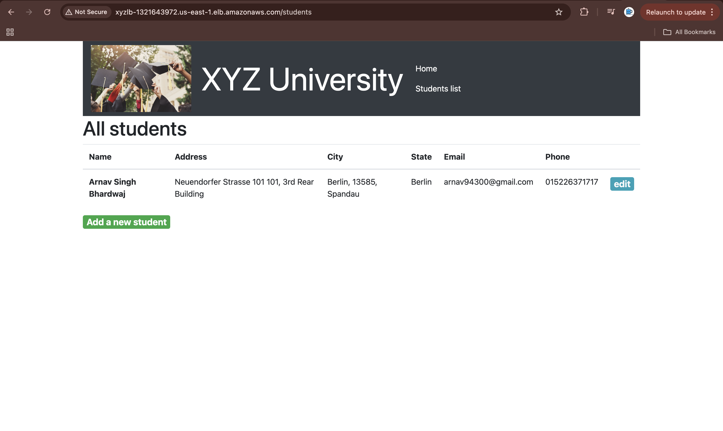
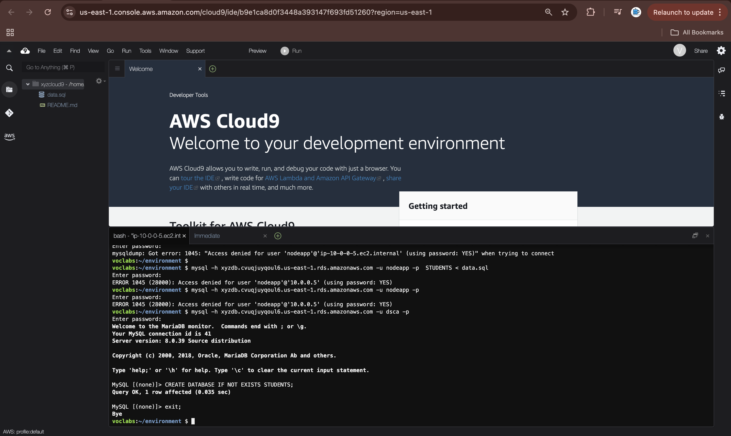
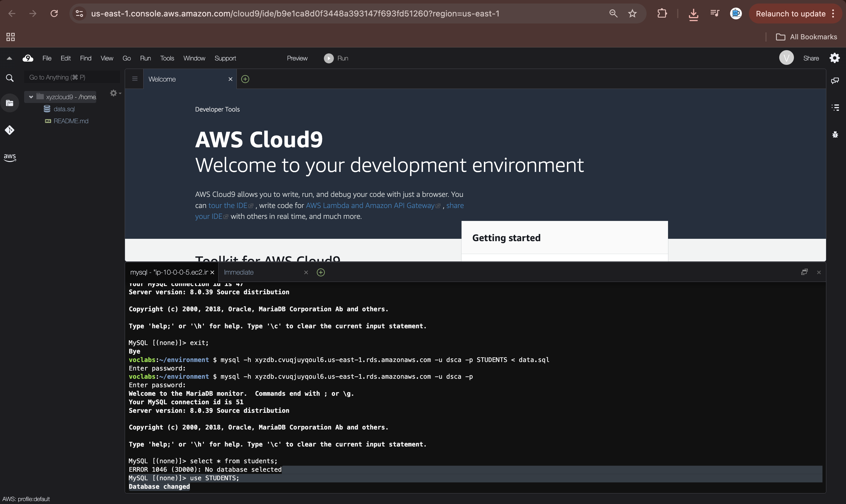
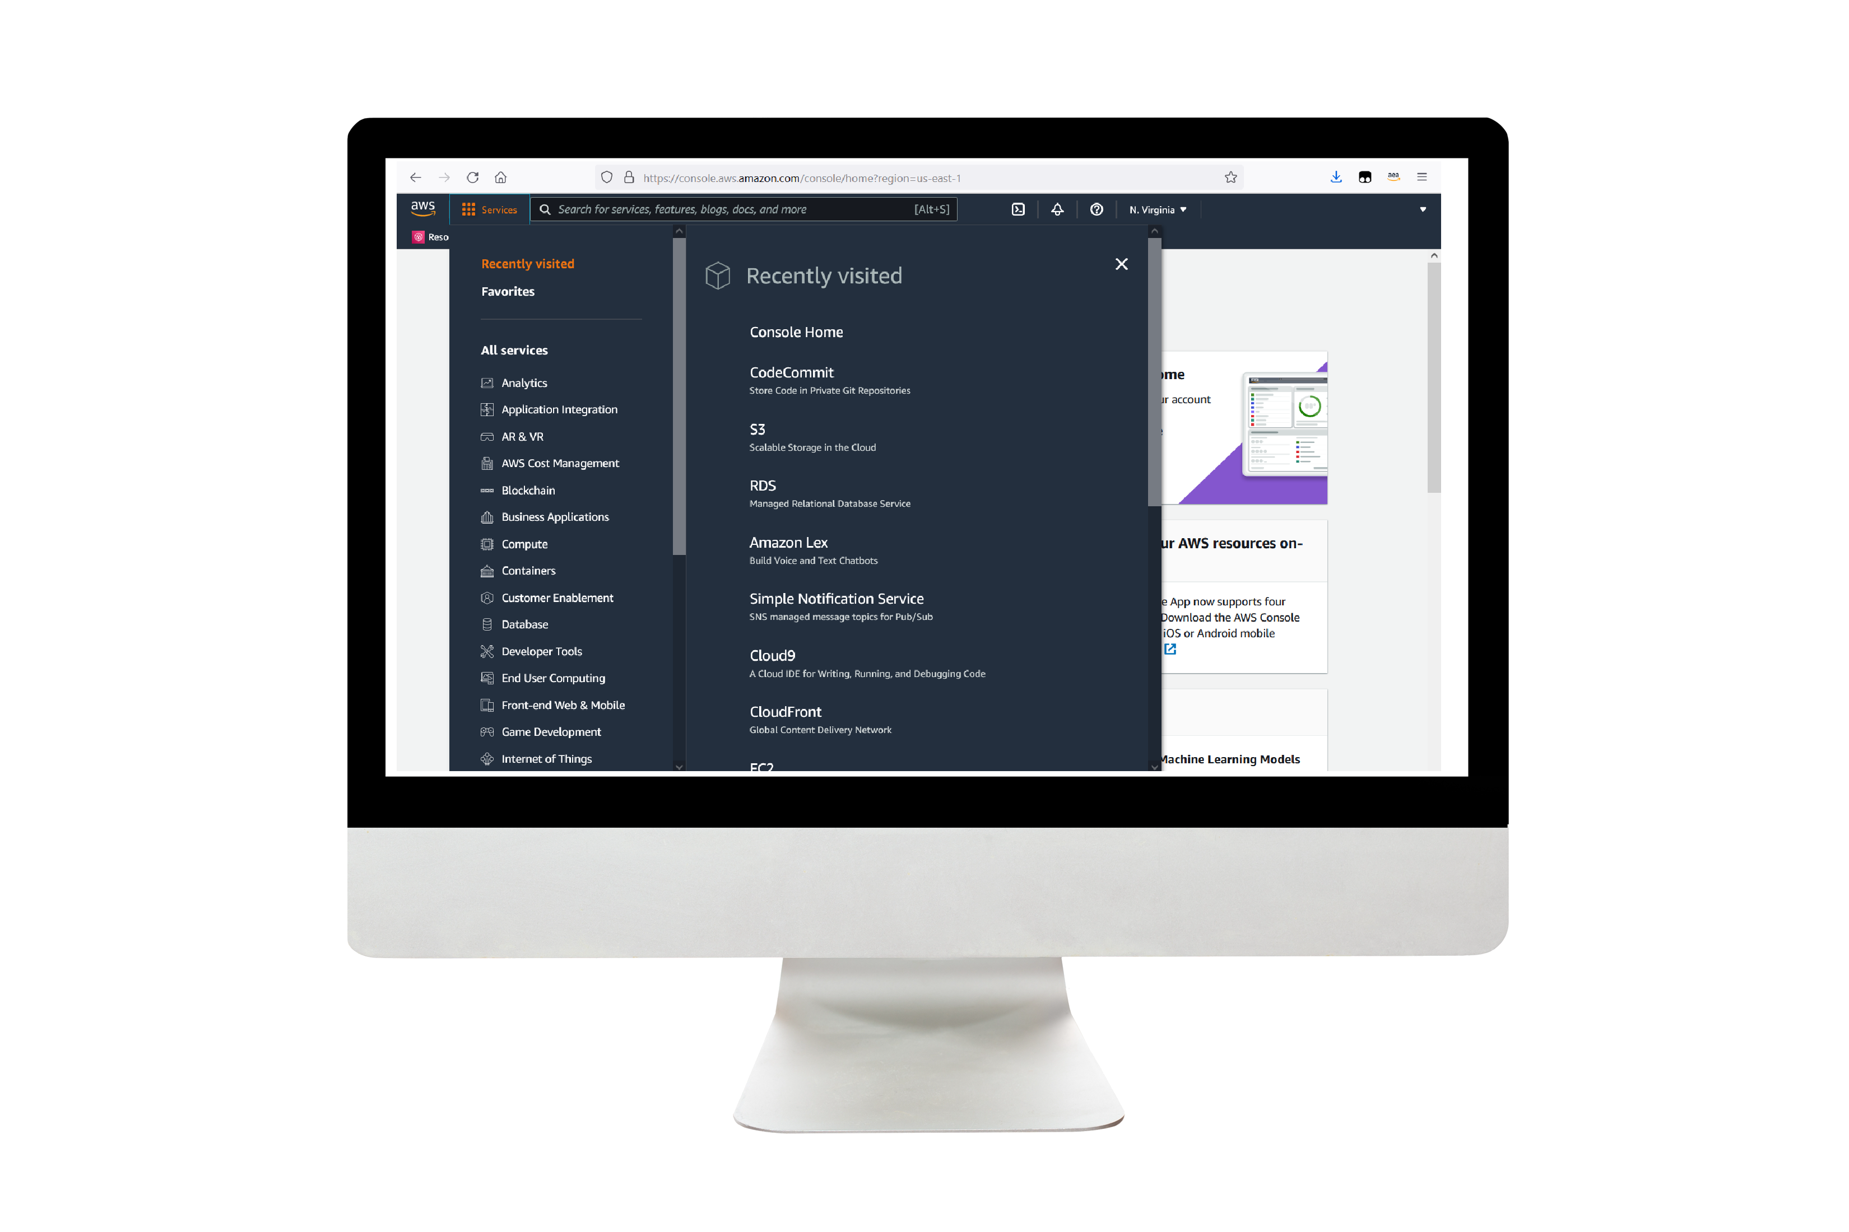
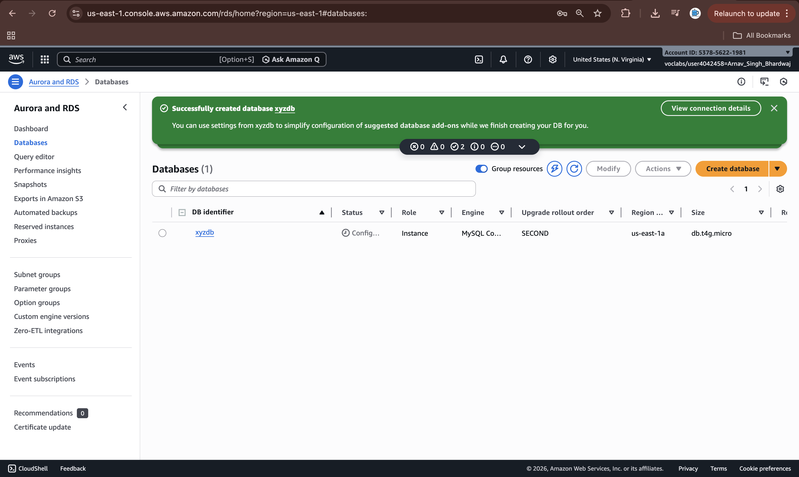
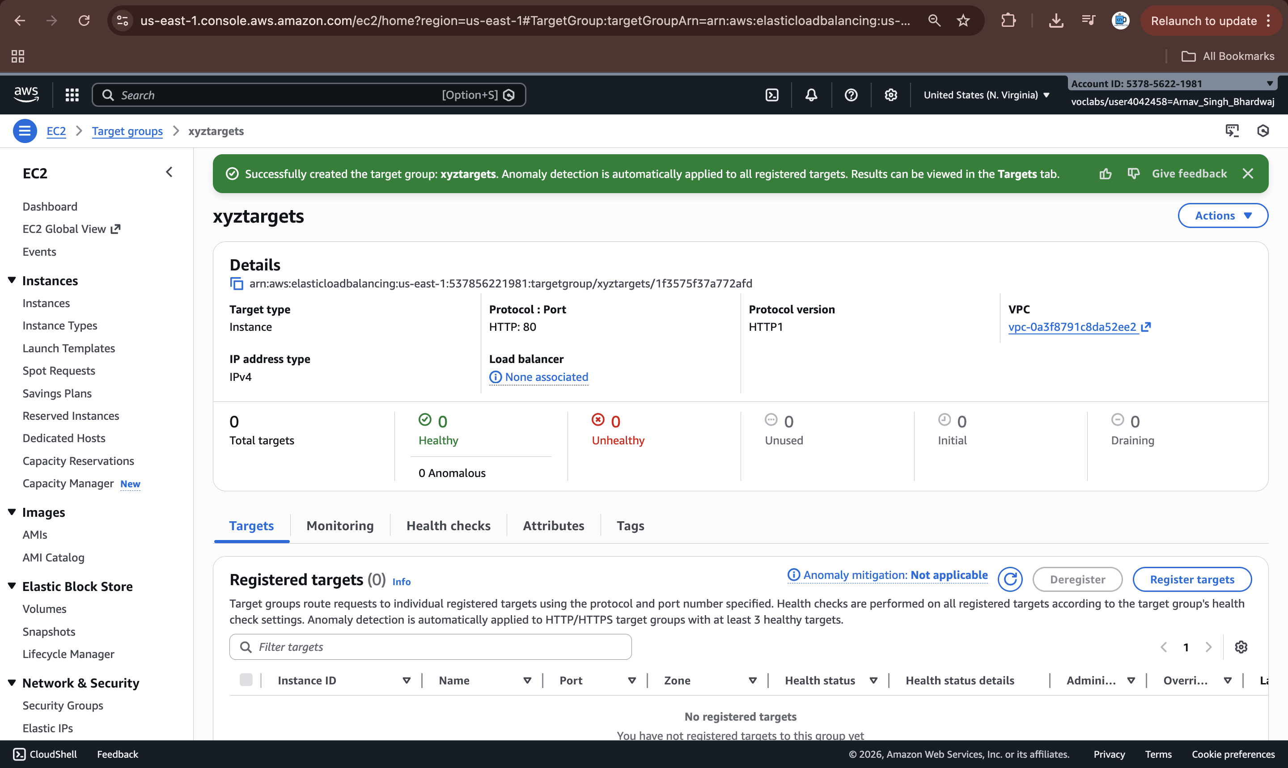
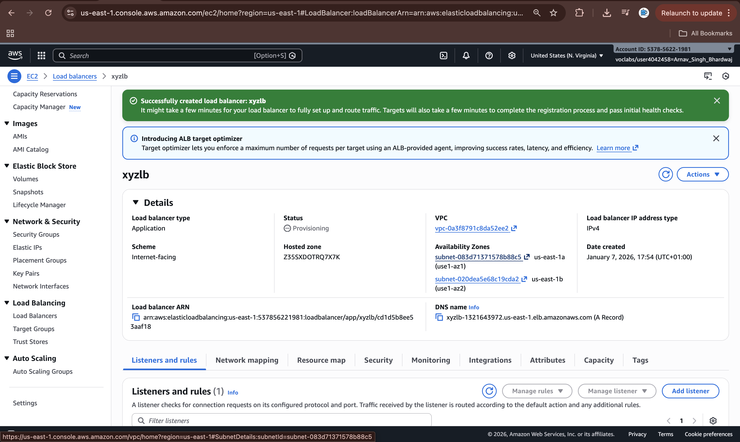
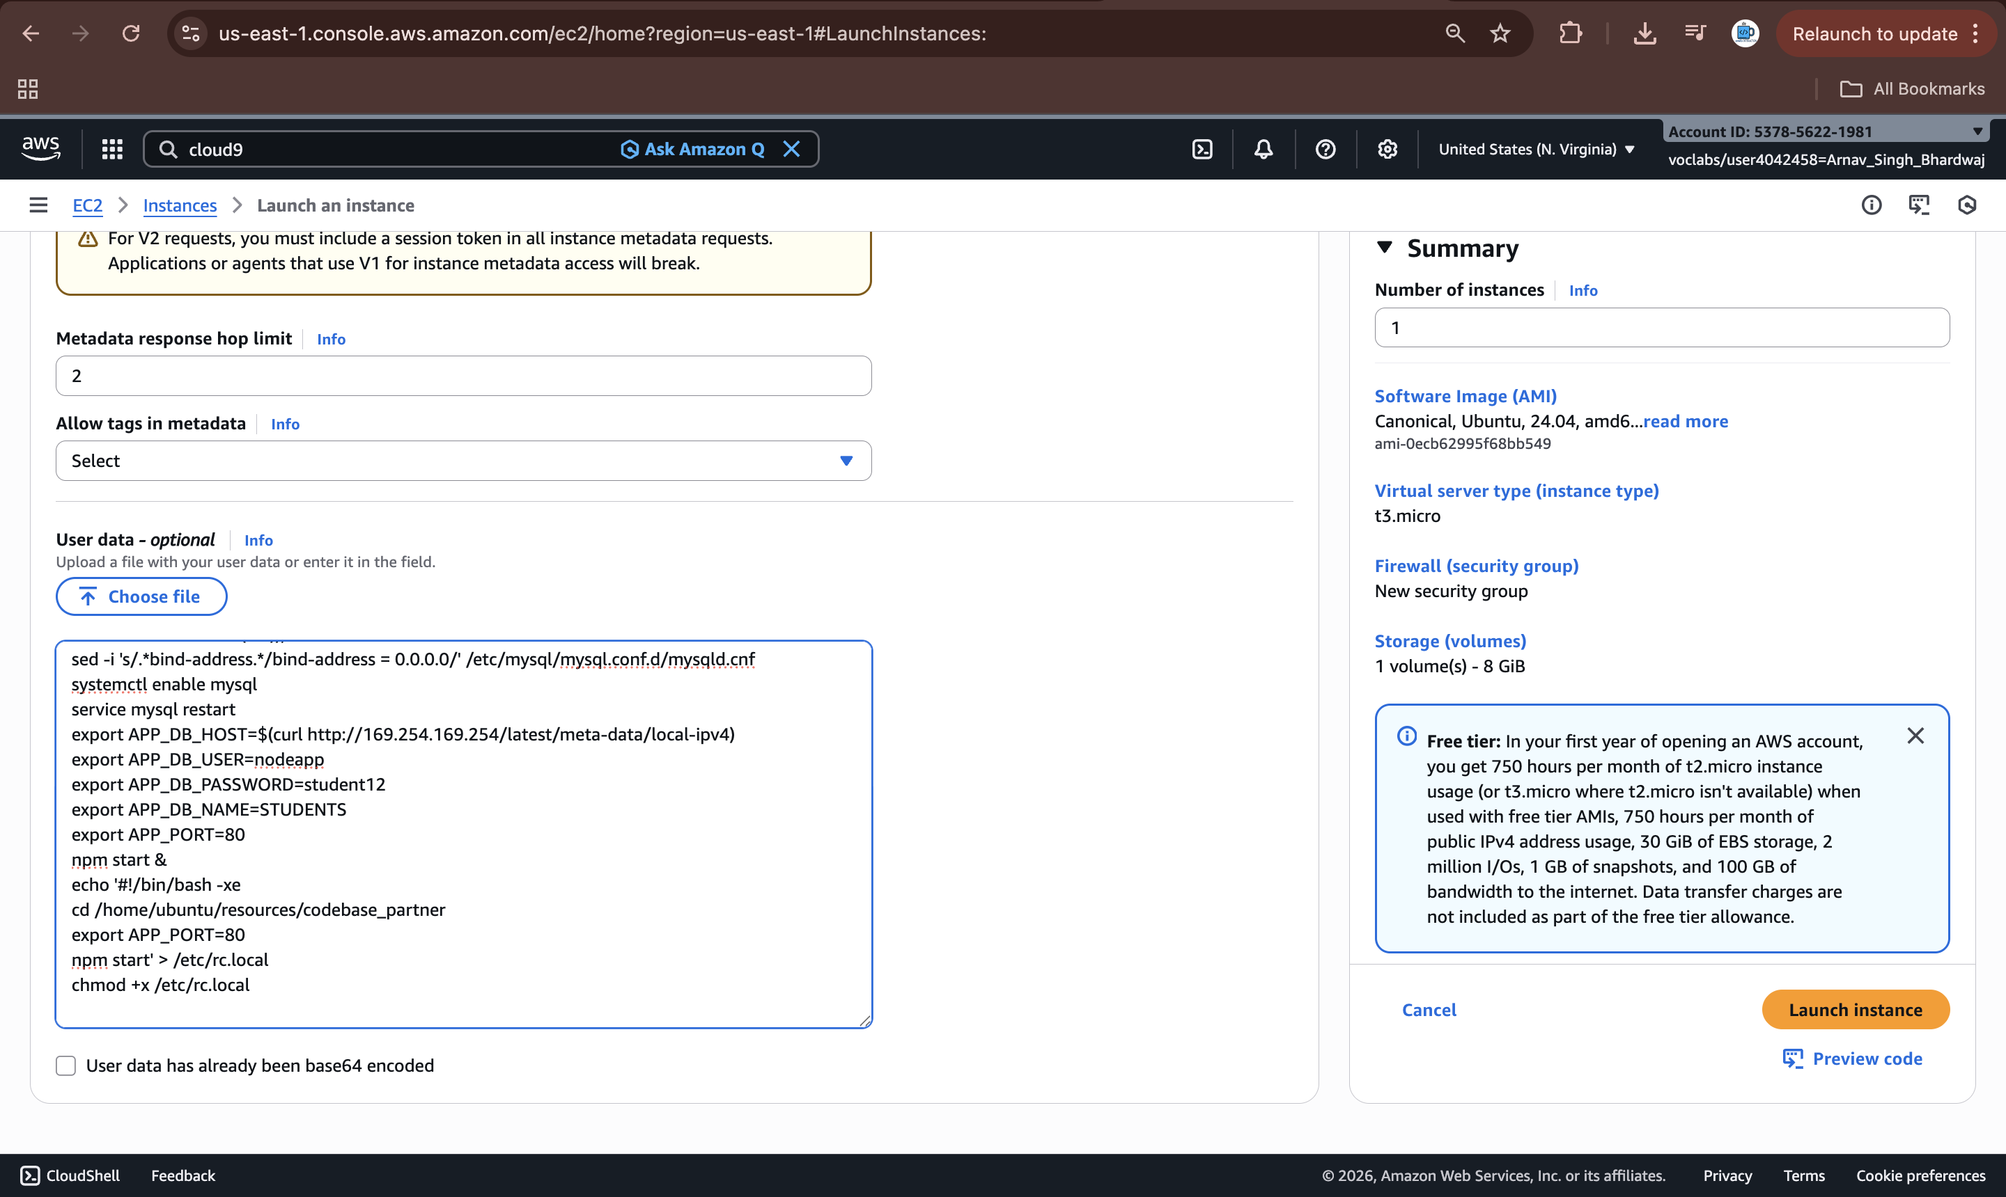
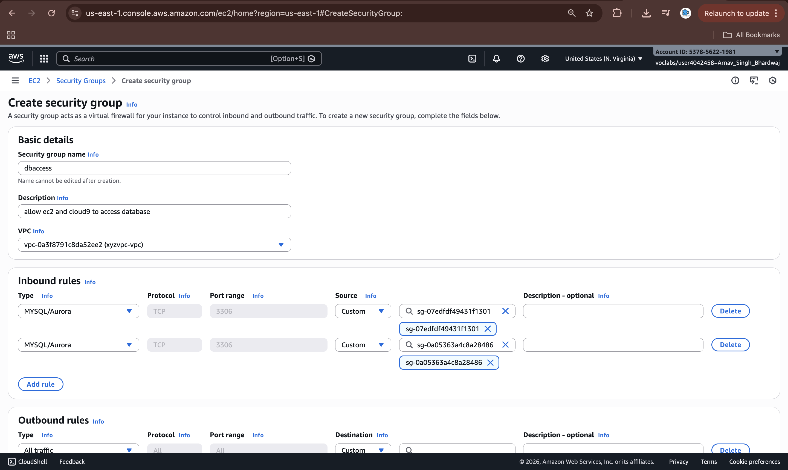
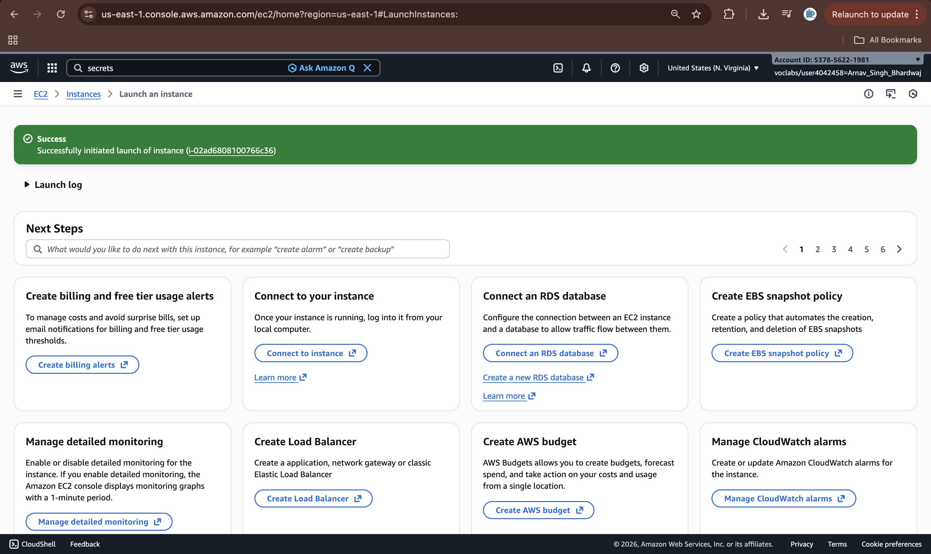
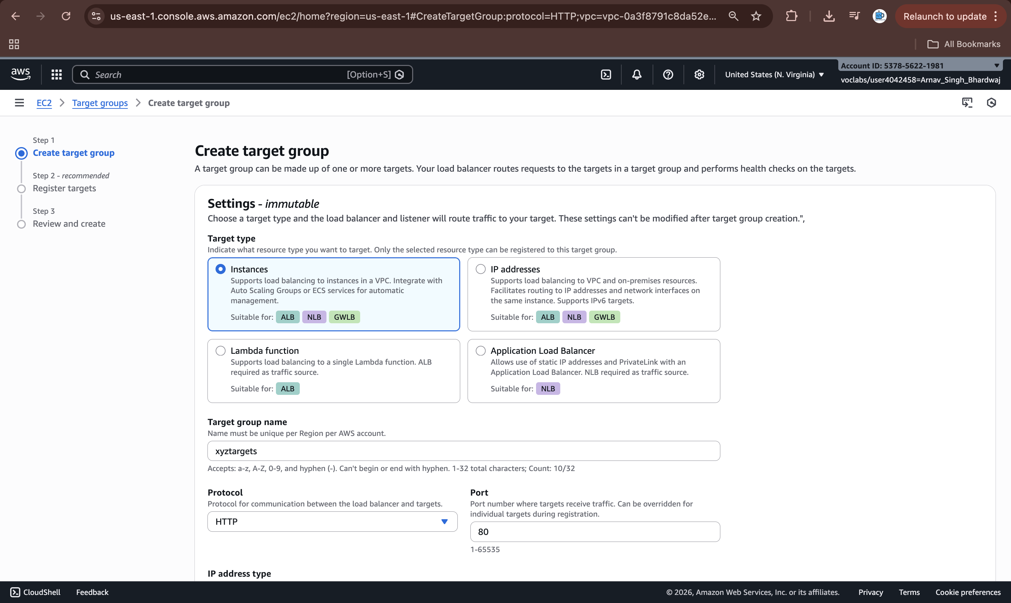
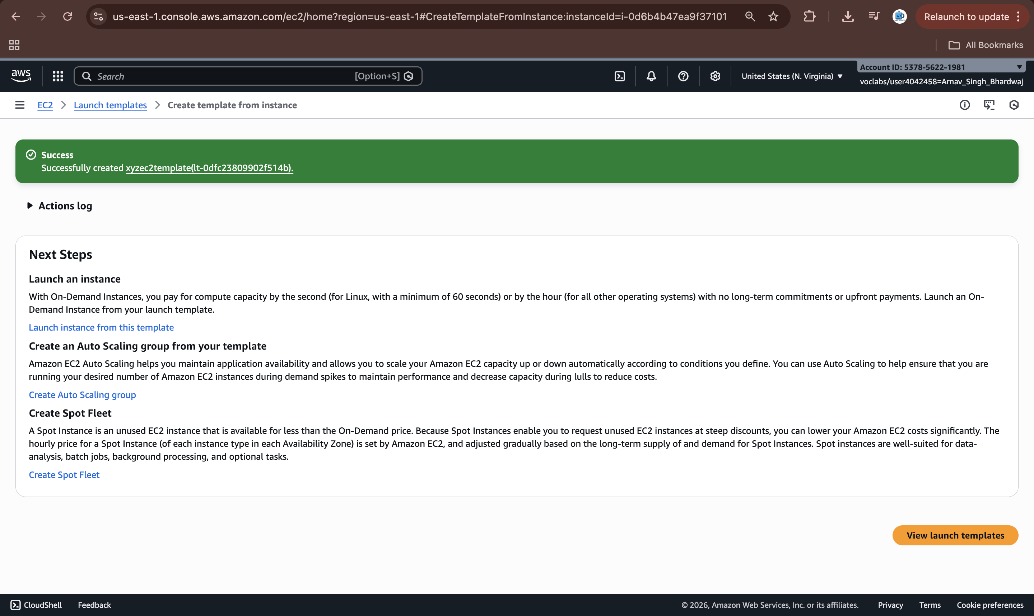
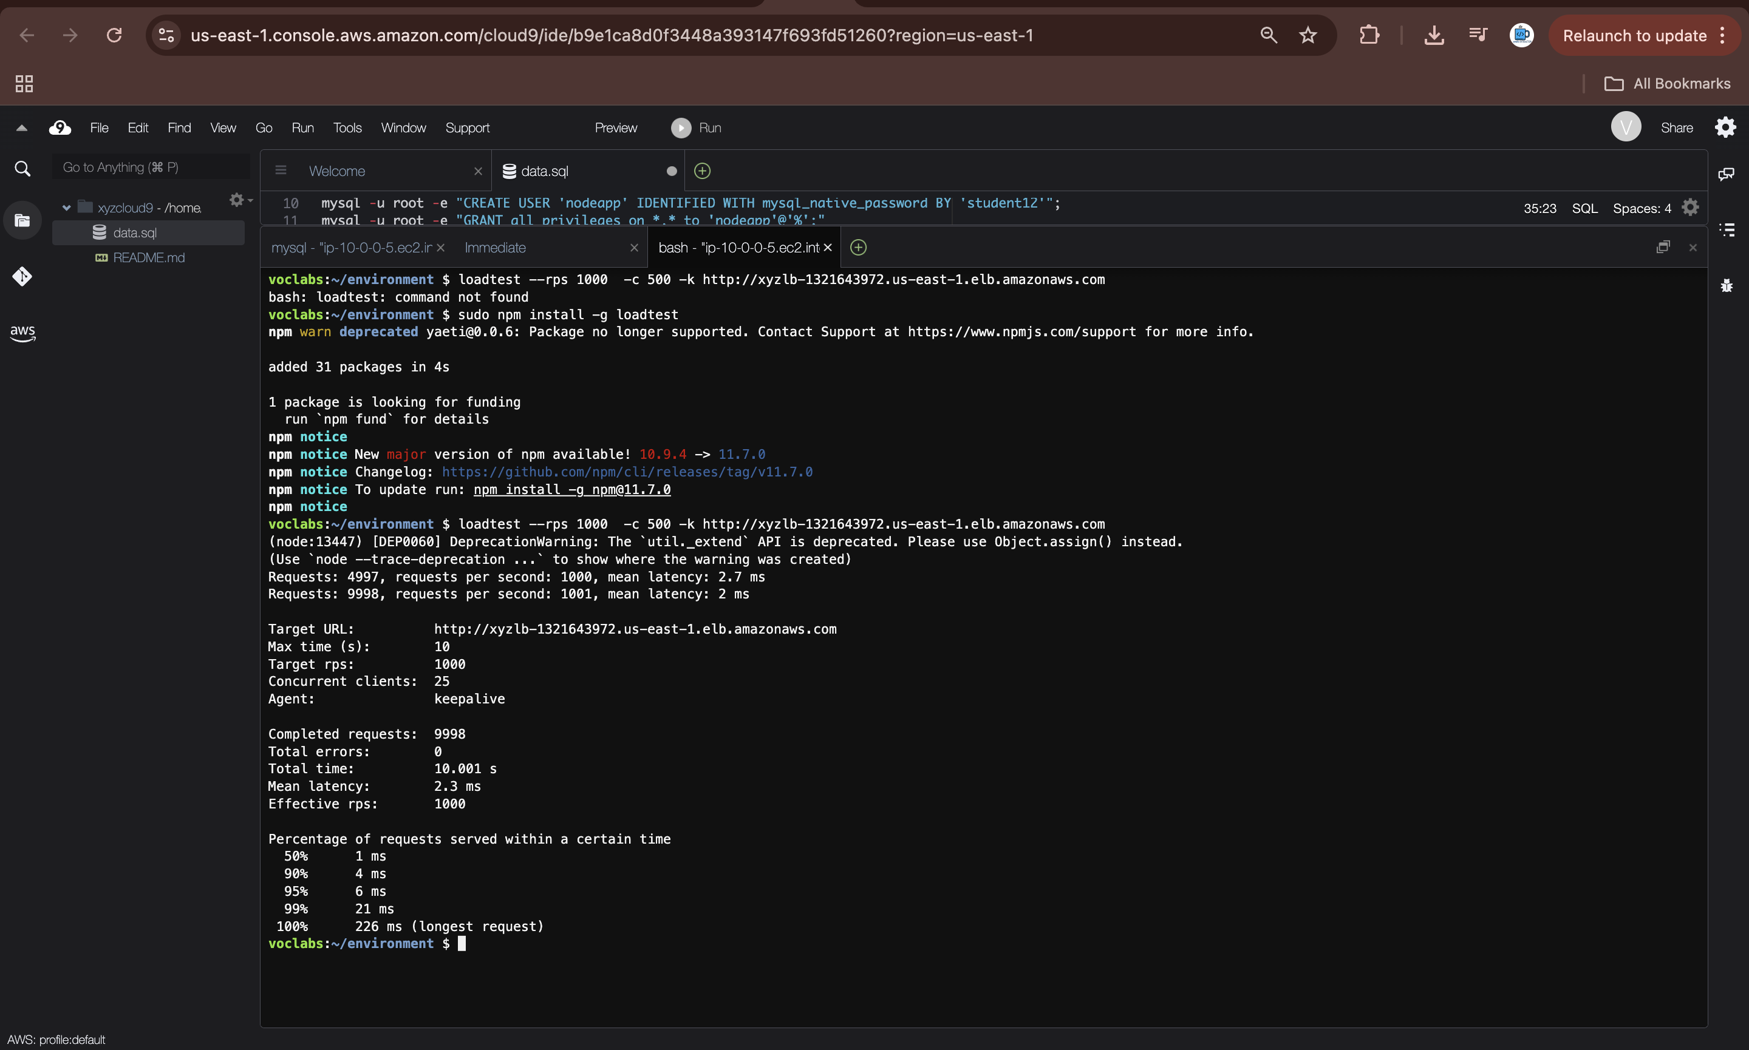
Demo
Link to the screenshots for tasks performed: https://bit.ly/4qiLnI9
Notes:
For the demo, guide the audience through the two to three most important benefits of the solution and how it addresses the requirements.
Your demo materials can be screen captures, recordings, a link to your final solution, and/or a link to AWS console.

Slide 7
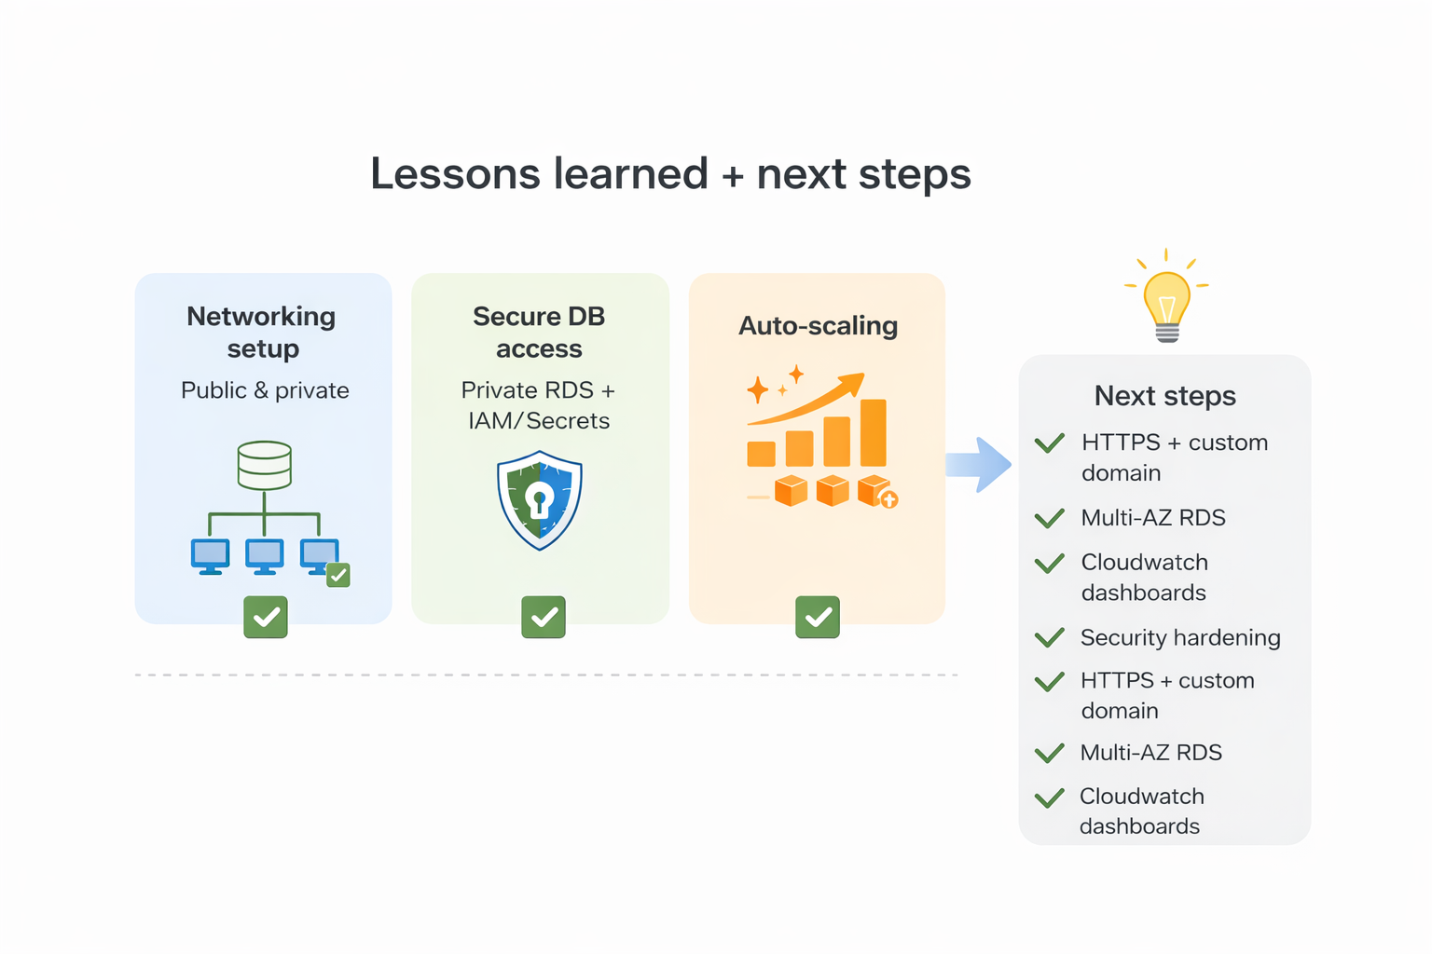
Lessons learned
Challenges that we overcame:
Networking setup: separating public vs private subnets and routing correctly (fixed by validating routes + SG rules)
Secure DB access: ensuring RDS is private and reachable only from the app tier
Secrets integration: removed hardcoded DB creds by using Secrets Manager + IAM instance profile (LabRole)
New skills used/learned:
Built a 2-tier VPC design (public ALB, private app, private DB)
Configured ALB target groups + health checks for self-healing
Implemented EC2 Auto Scaling with target tracking (scale out/in based on demand)
Helpful resources:
AWS Well-Architected Framework (Reliability, Security, Cost Optimization)
AWS Academy labs: VPC, RDS migration, Highly Available Environment
AWS service docs: ALB target groups, Auto Scaling policies, Secrets Manager CLI
Next steps:
Improve DB resilience: Multi-AZ RDS and automated backups (if allowed)
Add observability: CloudWatch dashboards + alarms, centralized logs
Notes:
Describe any challenges that you encountered and how you overcame those challenges.
For example: “I got stuck when I was creating an EC2 instance to host the application. I used the resources that were listed in the instructions to walk myself through the process to create a new EC2, and I was able to complete the task. The links to labs in other courses were very helpful.”
Describe any new skills that you learned from this project.
For example: “I learned how to set up auto scaling correctly so my resources were automatically adjusted and allocated at the lowest possible cost.”
Discuss any future, out-of-scope use cases in the next steps.
For example: “I would like to scale out the web application so that multiple departments can use it.”

Slide 8
Thank you

